Slide 1
Op Amp
Operational Amplifier

Slide 2
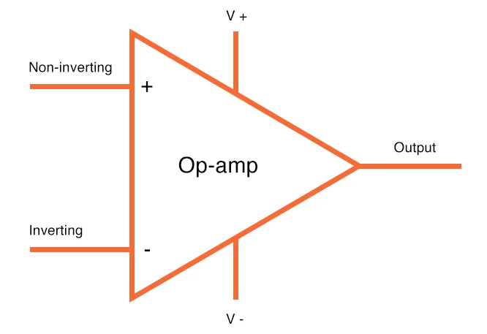
What is an Op-Amp?

Slide 3
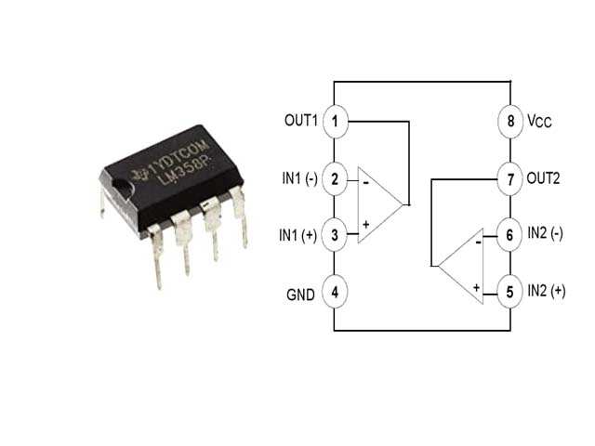

Slide 4
Basic amplifier circuit with op amp

